Slide 1
Textiles 8 Basic Supplies
Walnut Grove Secondary School
Notes:
This template can be used as a starter file to give updates for project milestones.
Sections
Right-click on a slide to add sections. Sections can help to organize your slides or facilitate collaboration between multiple authors.
Notes
Use the Notes section for delivery notes or to provide additional details for the audience. View these notes in Presentation View during your presentation.
Keep in mind the font size (important for accessibility, visibility, videotaping, and online production)
Coordinated colors
Pay particular attention to the graphs, charts, and text boxes.
Consider that attendees will print in black and white or grayscale. Run a test print to make sure your colors work when printed in pure black and white and grayscale.
Graphics, tables, and graphs
Keep it simple: If possible, use consistent, non-distracting styles and colors.
Label all graphs and tables.

Slide 2
See what you have at home first – do not need to buy new! Have these in the next 2 days

Slide 3
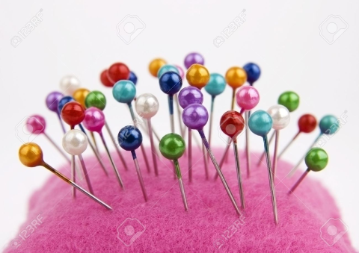
Straight Pins with a top
Dollar store are better than nothing

Slide 4
Hand sewing needle

Slide 5
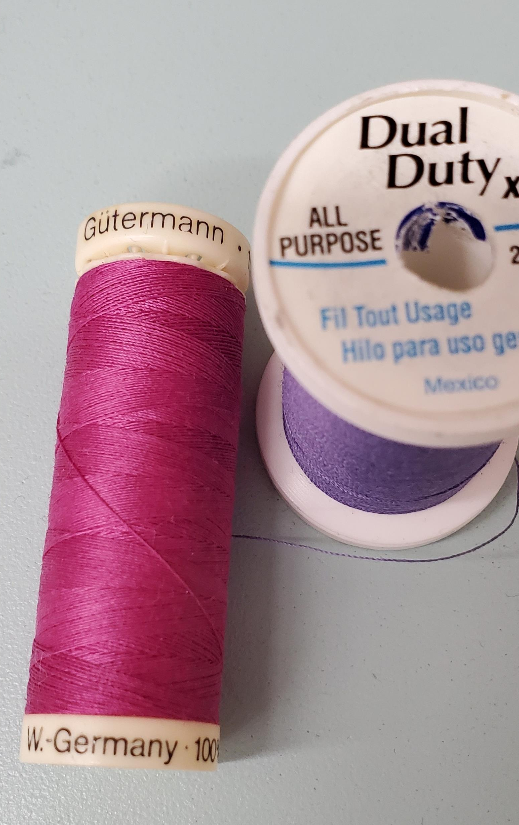
2 spools of All Purpose Thread for Samples
Thread can be half empty, and any color

Slide 6
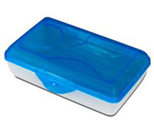
Pencil box for supplies
Anything type - to hold all their sewing supplies

Slide 7
1 or 2 Duo Tang folders
Labeled
Information/class notes
Sewing Samples

Slide 8
$1.00 to rent a Bobbin
DUE NEXT CLASS
Students will get the money back at the end of the class.
If they loose their bobbin they will have to pay for a new one.

Slide 9
Optional Equipment

Slide 10
Snipping Scissors or Small scissors
Any small scissors that you may have at home will be fine

Slide 11
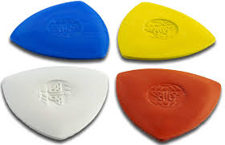
Tailors Chalk or Friction Pen

Slide 12
Bring everything in the next 2 days
Label all your supplies

