Slide 1
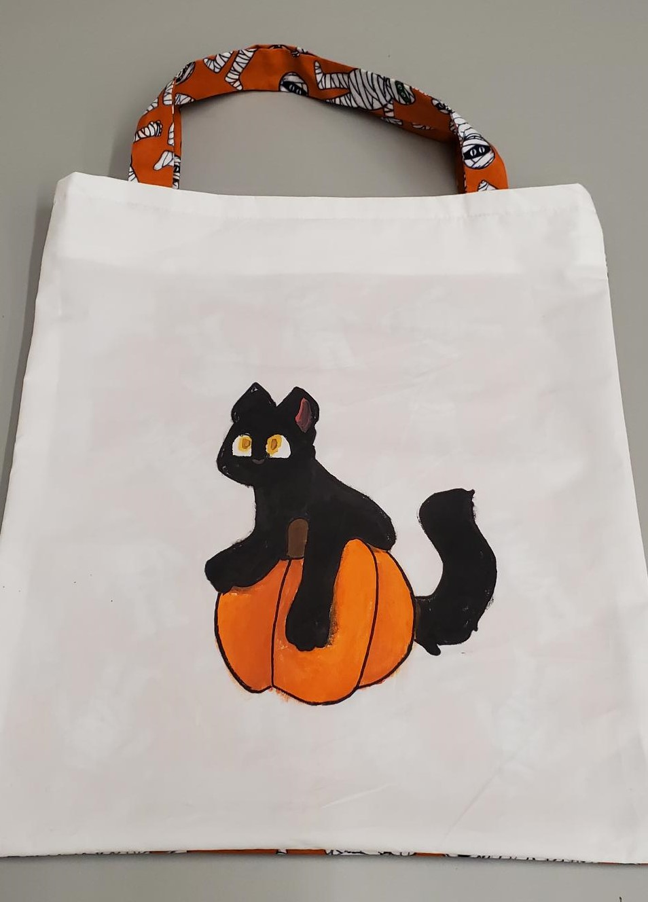
Halloween Trick or Treat Bags
Visual Instructions

Slide 2
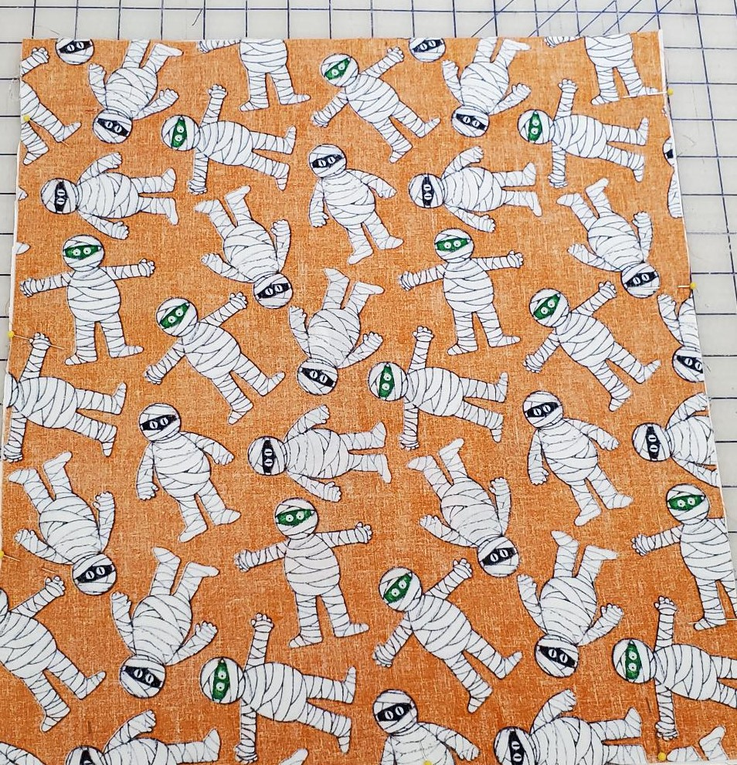
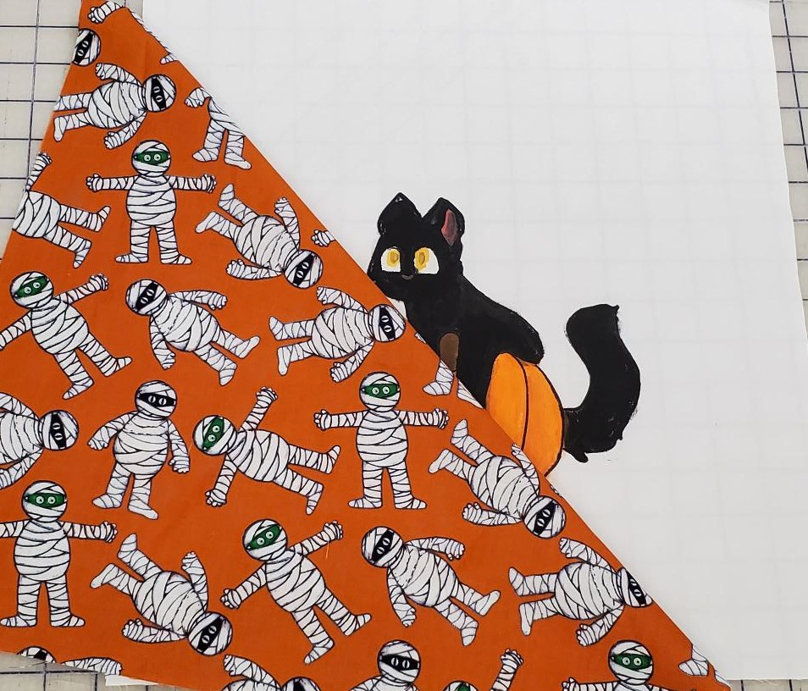
Place right sides of fabric together

Slide 3
Pin 3 sides leave the top of the bag unpinned

Slide 4
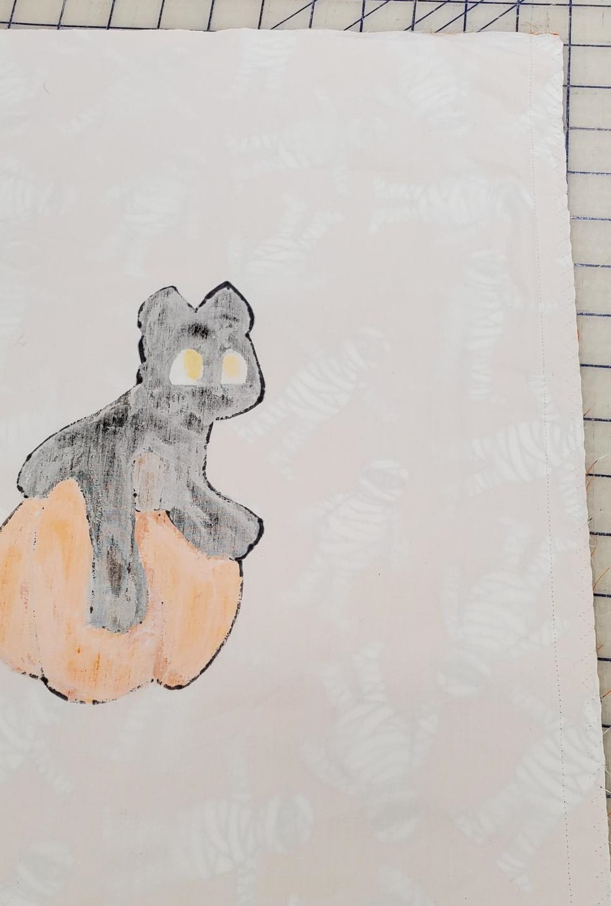
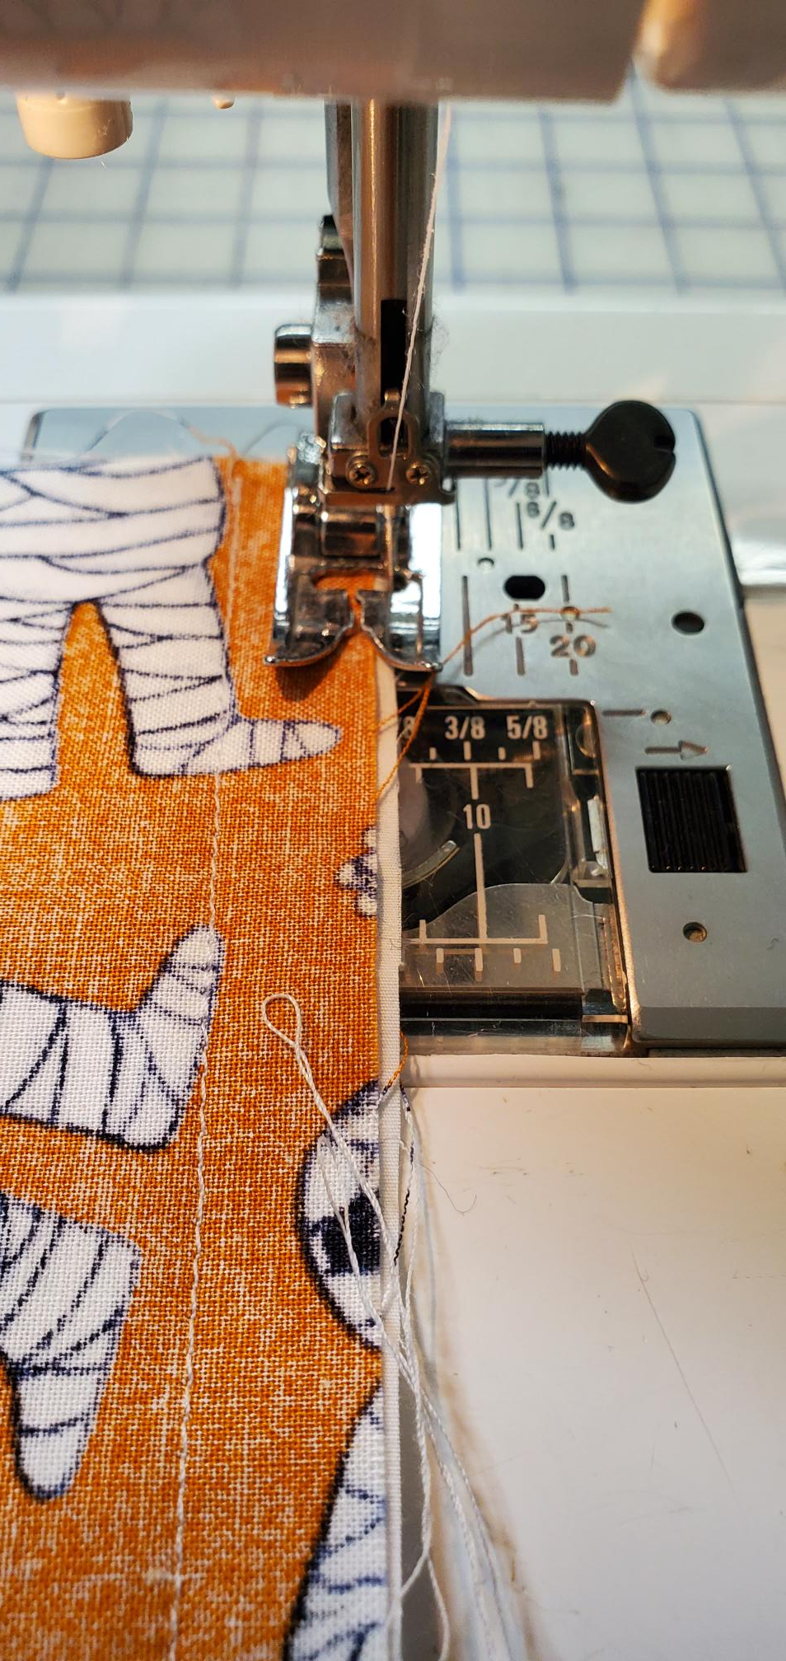
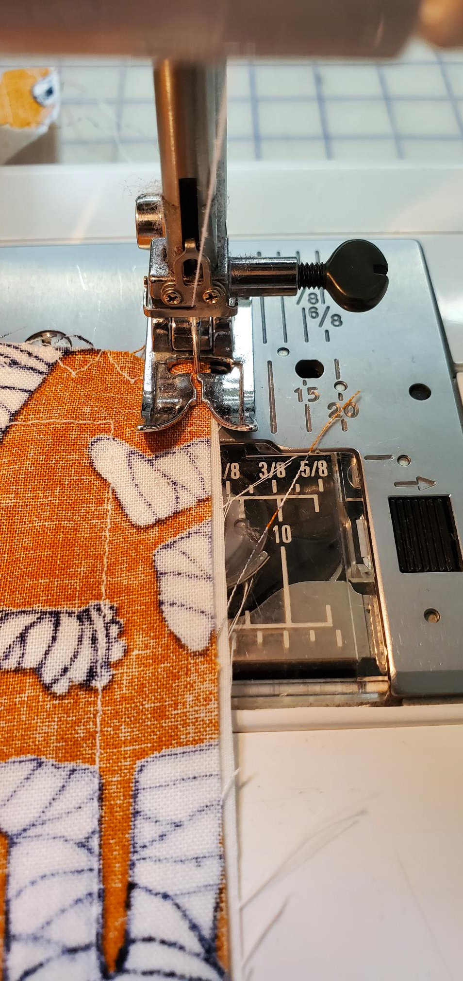
Sew at a 1.5 cm seam allowance 3 sides
Multi-zigzag all 3 sides
Pivot at the corners for the Muti zig-zag
Finished sewing and multi zig-zag

Slide 5
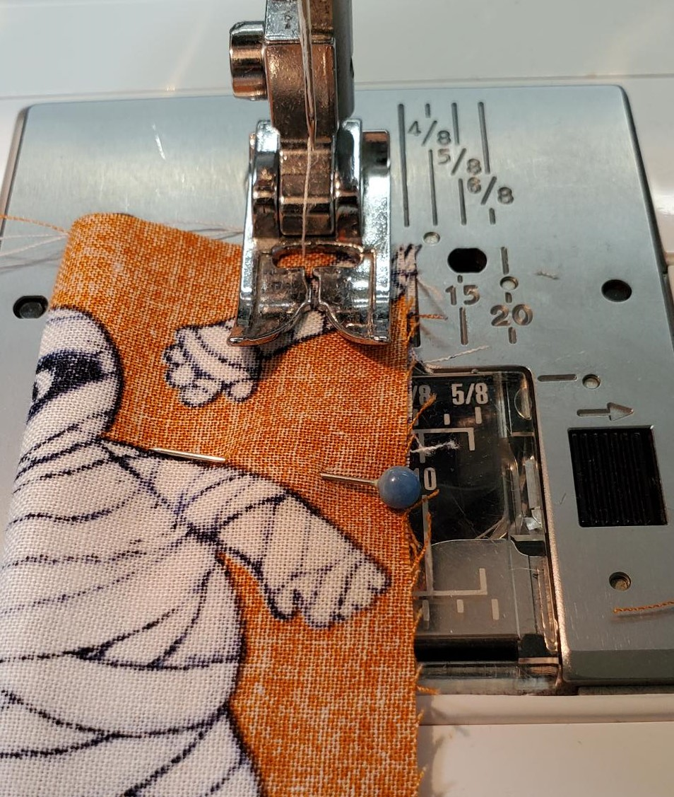
Handles
Sew with a 1cm seam allowance the length of the handles
Fold handles good sides together and pin
Repeat on second handle

Slide 6
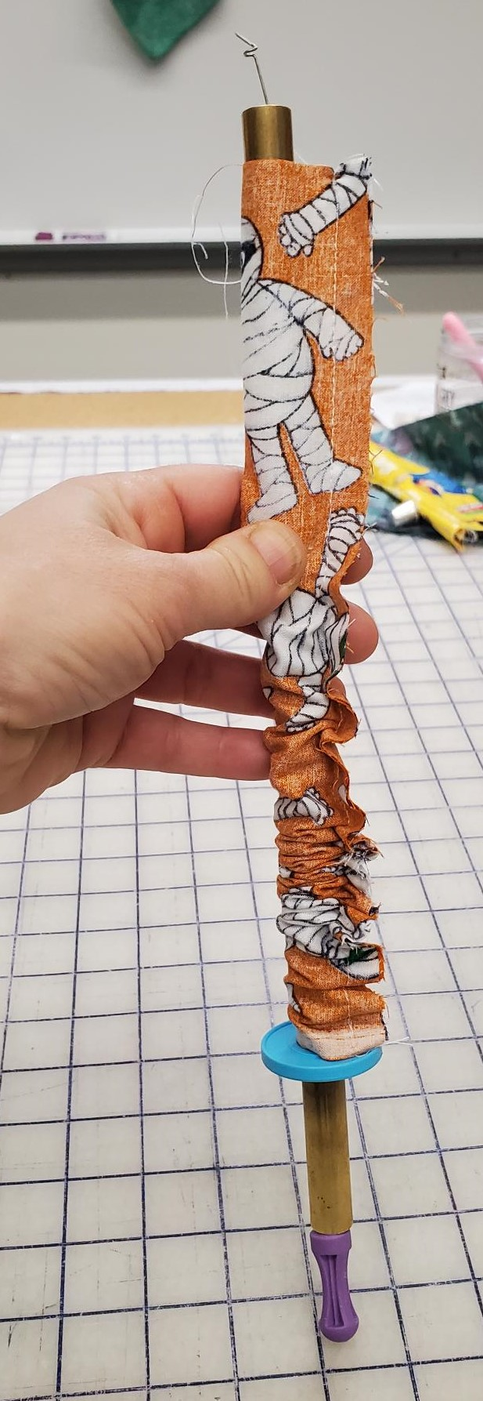
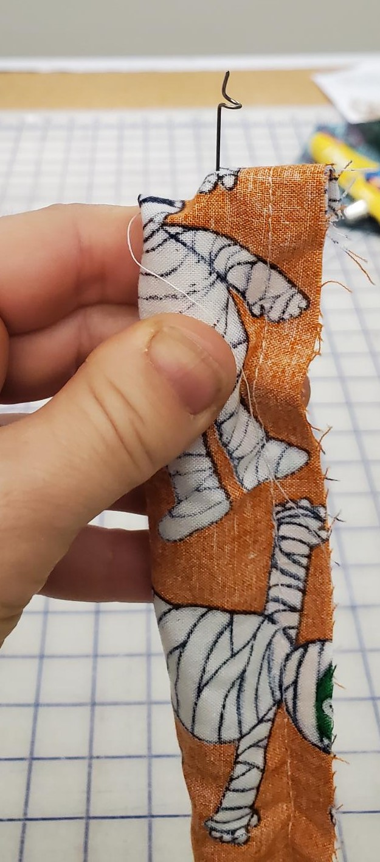
Handles continued – use the fast turner to turn the handle so the good side is facing out

Slide 7
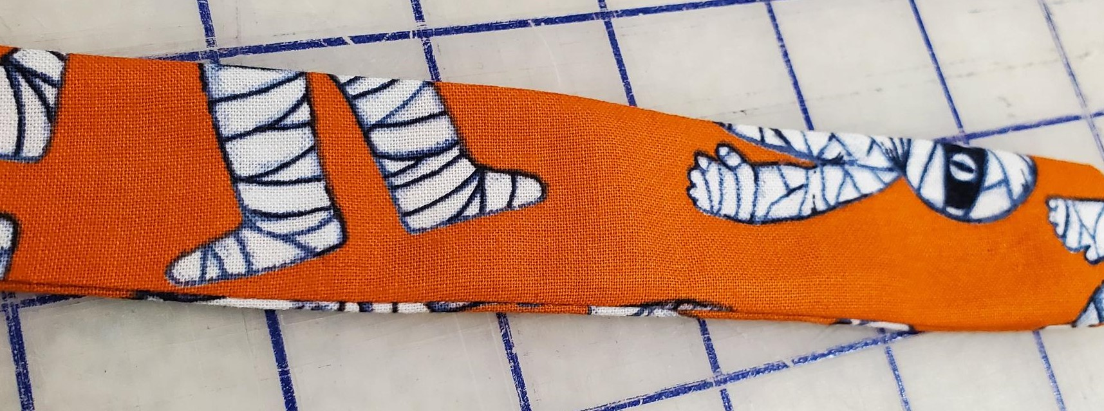
Press handles so the seam is “crisp”

Slide 8
Measuring for placement of handles to the bag
Measure 2 inches from EACH side of the bag and make a mark
Repeat on the other side

Slide 9
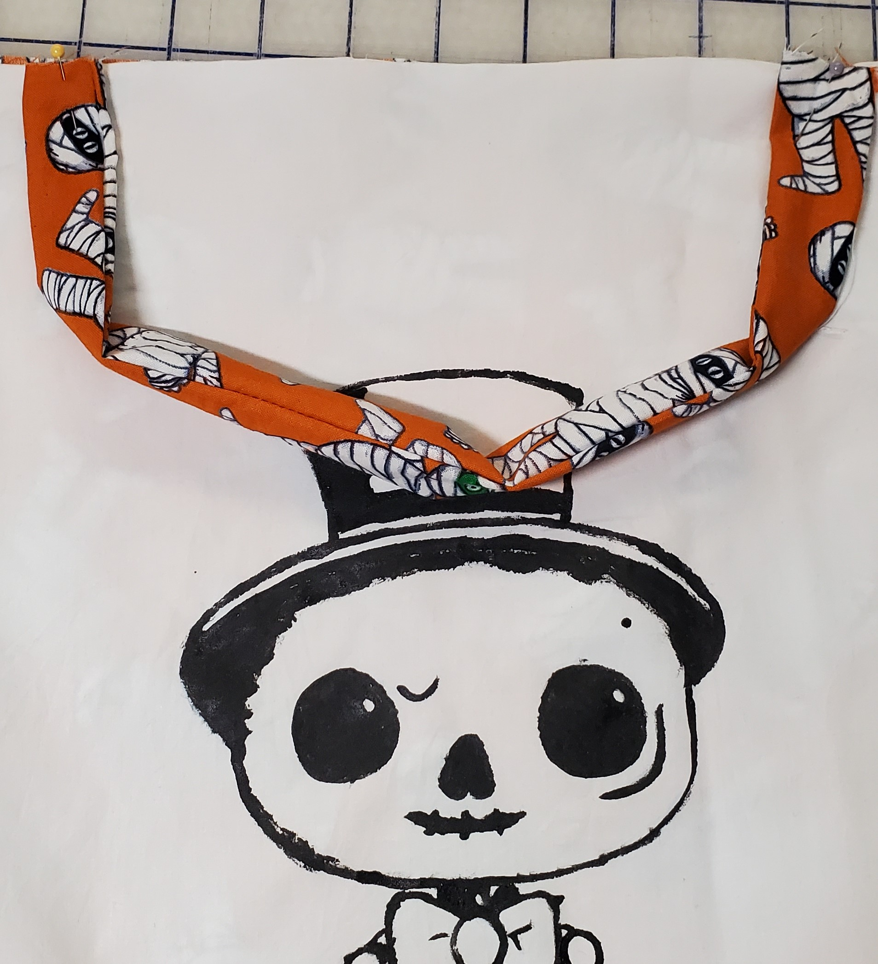
Attaching handles to bag
Pin the raw edge of the handle to the top of the bag beside where you marked the 2 inches.
Seam of the handle should face to the inside
Repeat on other side of bag with the other handle

Slide 10
Attaching the handles
Baste stitch (5,A,4) each handle in place at a
1 cm seam allowance

