Slide 1
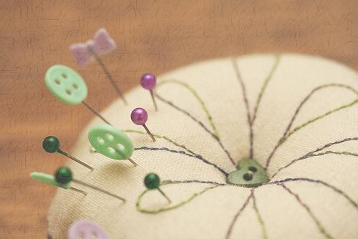
An Introduction to Fabrics

Slide 2
Reasons to take a basic course
Make it your own
Make gifts/ own clothes
Future jobs
Able to mend/repair/hem
Smart consumer

Slide 3
Generic Names
Cotton
Polyester
Nylon
Silk
Wool
Acrylic

Slide 4
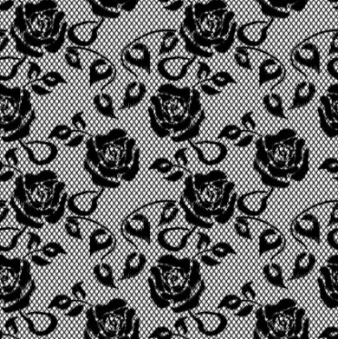
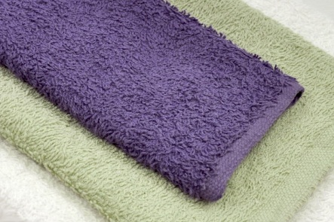
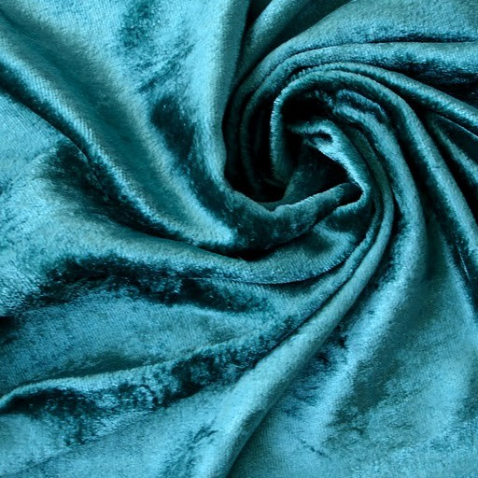
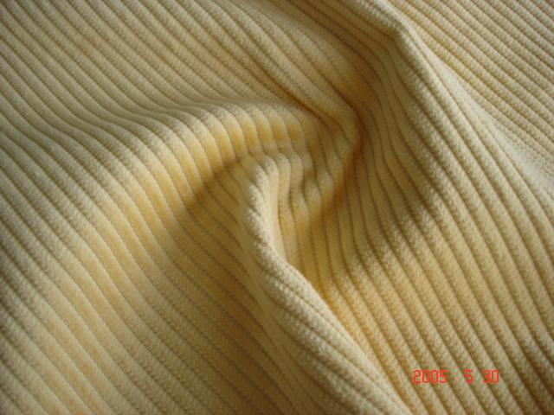
Construction Names
Denim Satin
Lace Terry Cloth
Velvet Corduroy

Slide 5
Natural Fabrics
Cotton
Silk
Linen
Bamboo
Hemp

Slide 6
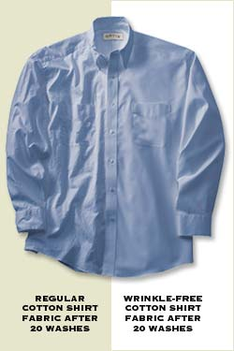
Natural Fabrics
Advantages
Disadvantages
Absorbent
Comfortable
Naturally made
Less Allergies
Shrinks
Wrinkles

Slide 7
Synthetic Fabrics
Nylon
Spandex
Polyester
Rayon
Acrylic
Acetate

Slide 8
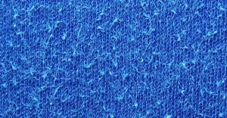
Synthetic Fabric
Advantages
Disadvantages
Won’t shrink
Wrinkle resistant
Non absorbent
Pilling
Static

Slide 9
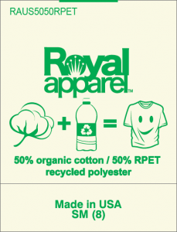
Blend Fabrics
Blend
To get the best qualities of all fibers
60% cotton, 40% Polyester
Look at your clothing tags

Slide 10
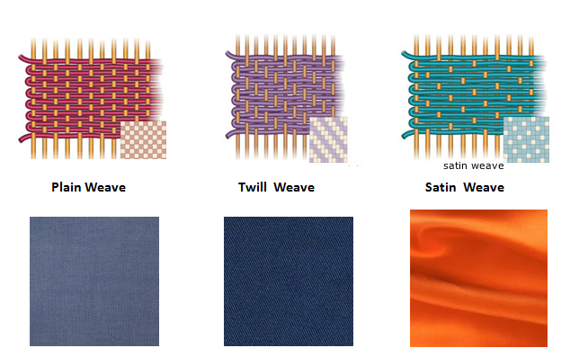
Woven Material – how it is made
Woven – interlocking at right angles
Very little stretch

Slide 11
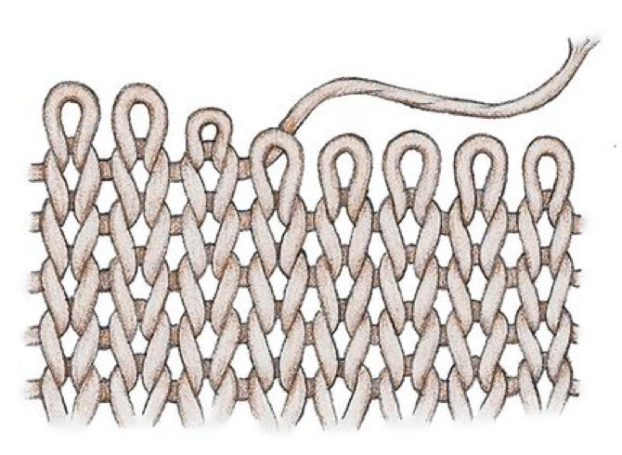
Knit Material – how it is made
Knitted

Slide 12
Jersey Knit

Slide 13
Pile Weave

