Slide 1
Review of Sewing Terms and Techniques
WGSS – Textiles 11

Slide 2
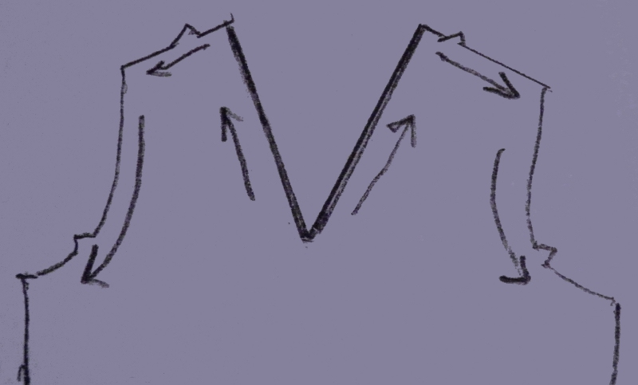
Stay stitching
- A row of directional stitching that is just barely inside your seamline, and helps to prevent your garment piece from stretching all out of shape during the inevitable handling of garment construction.

Slide 3
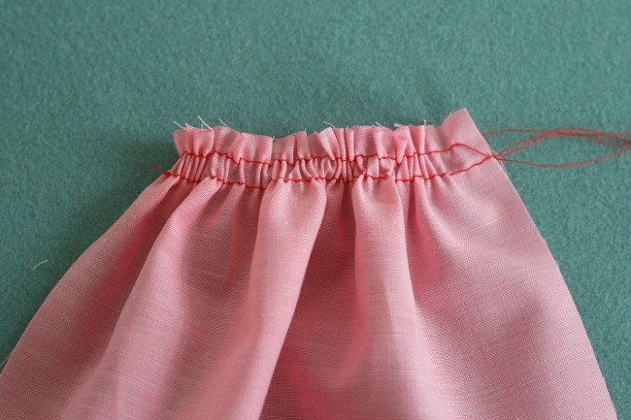
Gathering
To shorten the length of a strip of fabric so that the longer piece can be attached to a shorter piece

Slide 4
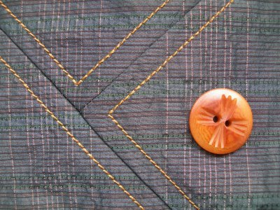
Topstitching
One or more rows of continuous stitches on the top or right side of a garment or other article as a decorative feature.

Slide 5
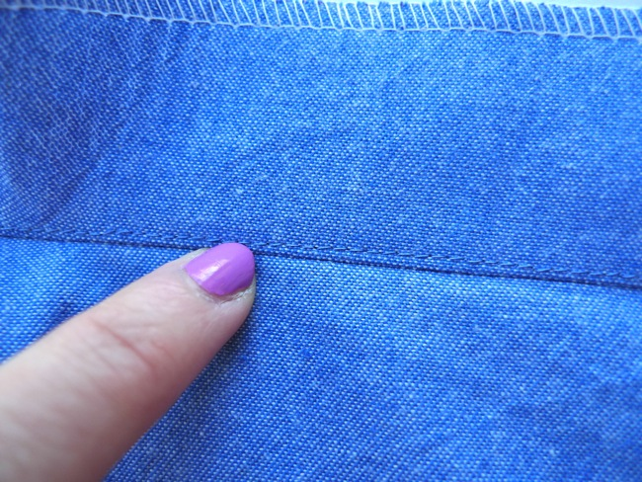
Under stitching
-assists a facing or lining to stay to the inside and un-seen. Sewn as close to the seam line as possible holding the graded seam allowance to the facing or lining.
-
Keeps facings and lining neatly out of sight

Slide 6
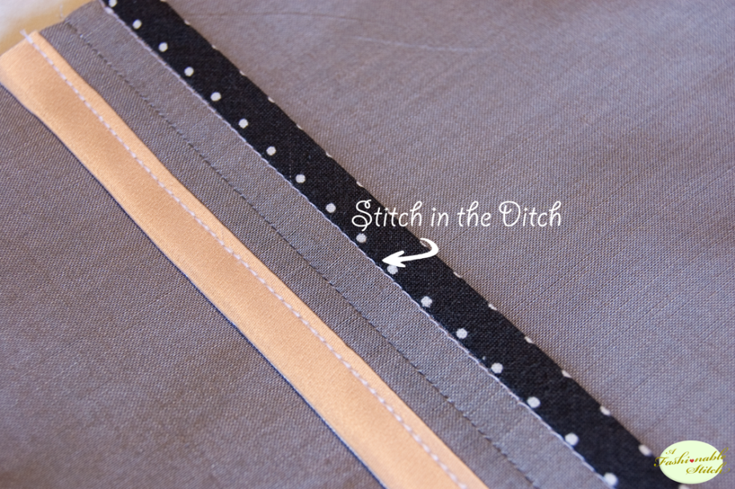
Stitch in the Ditch
Topstitching in the seam line so the it is invisible. To secure waistbands, facing, Hong Kong Seam Finish

Slide 7
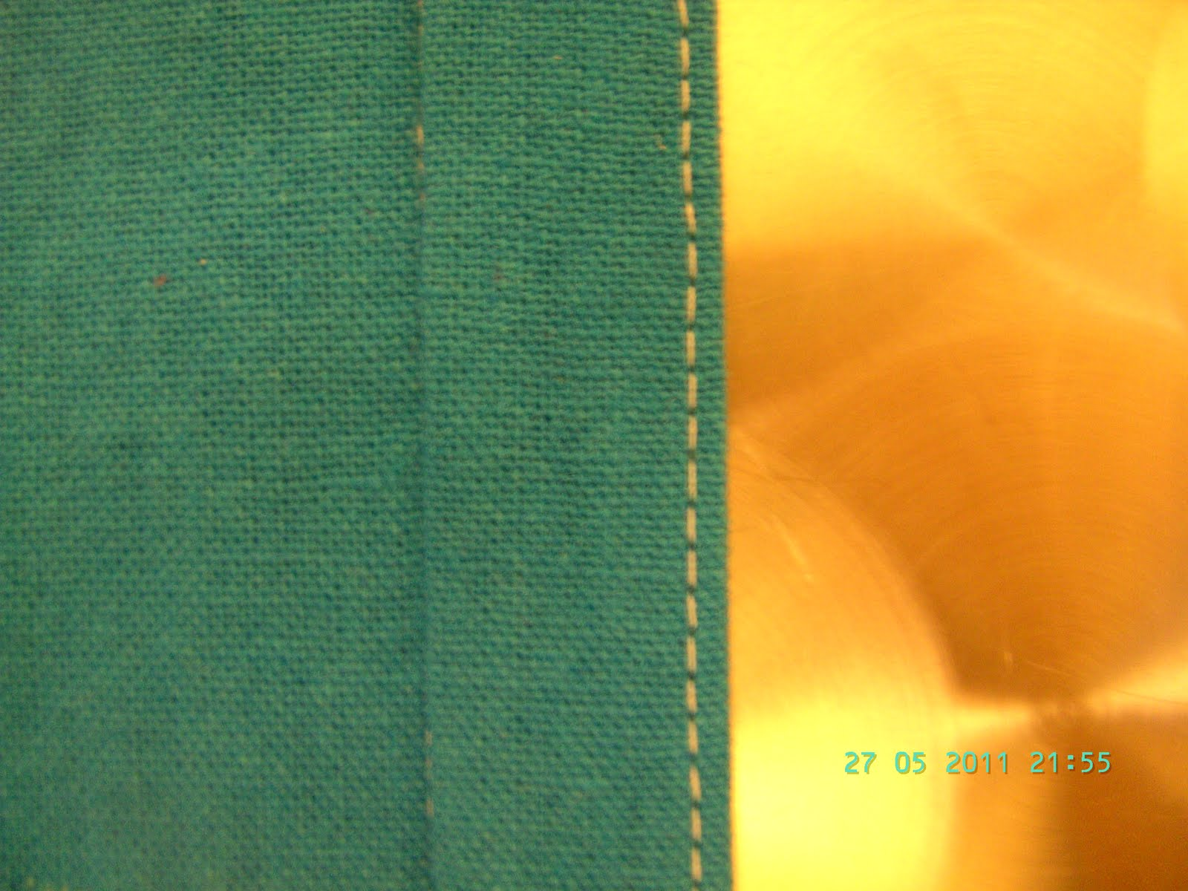
Edge stitching
a line of stitching 1/8″ away from a folded edge or seamline – like topstitching just really close to the Edge of the seam.

Slide 8
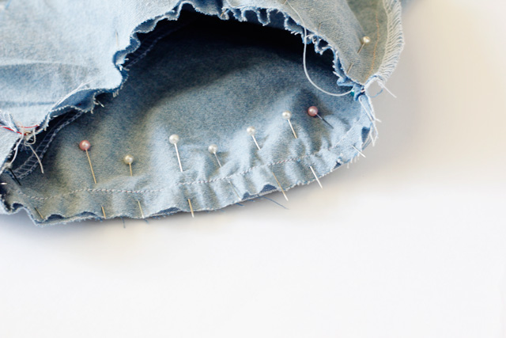
Ease stitching
"An ease stitch (also known as a gathering stitch) is simply a straight stitch using your longest stitch length. To bring or pull fabric fibers in to fit a smaller area without causing any puckers or gathers. Usually done to the sleeve cap of a garment.

Slide 9
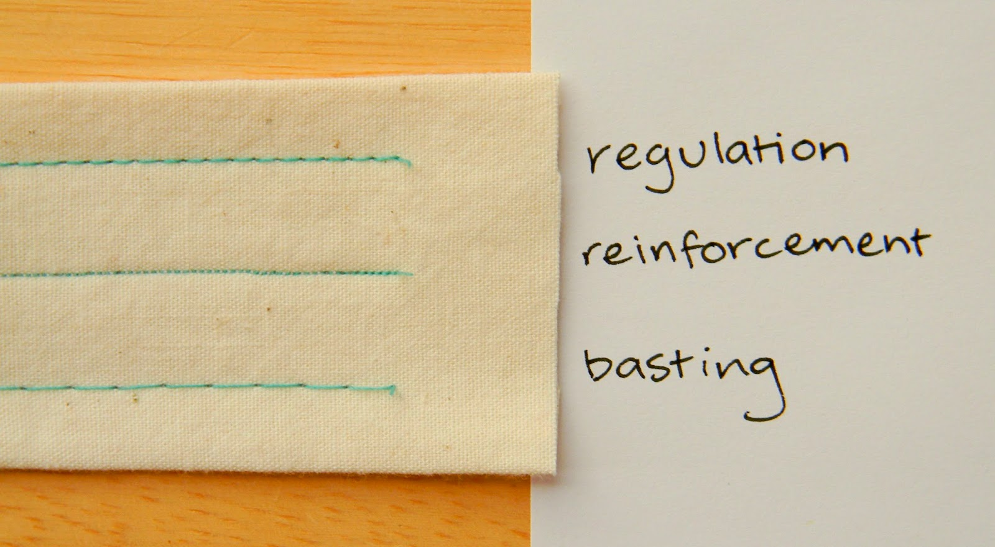
Baste stitch
To make quick, temporary stitching intended to be removed. Used to temporarily hold a piece of material in place. Use the longest stitch length on the machine or by hand.

Slide 10
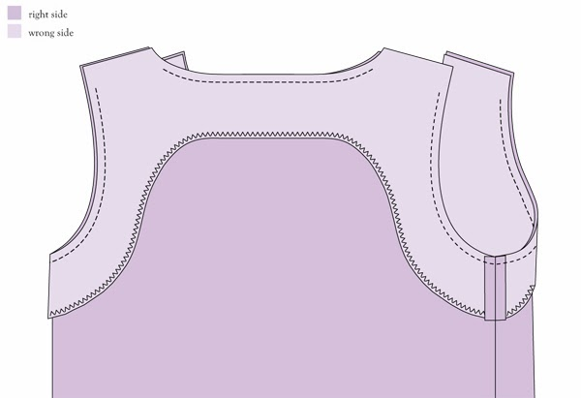
Facing
A facing is the area of a garment or sewn item that turns to the inside, giving a finished appearance to what would otherwise just be a raw edge of fabric.

Slide 11
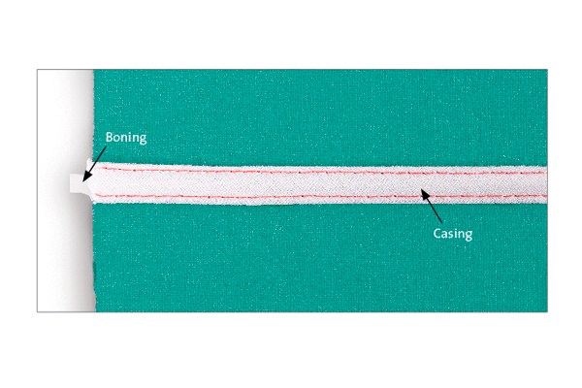
casing
A fabric tunnel through which elastic or a drawstring can be threaded to pull in or draw up the fabric.

Slide 12
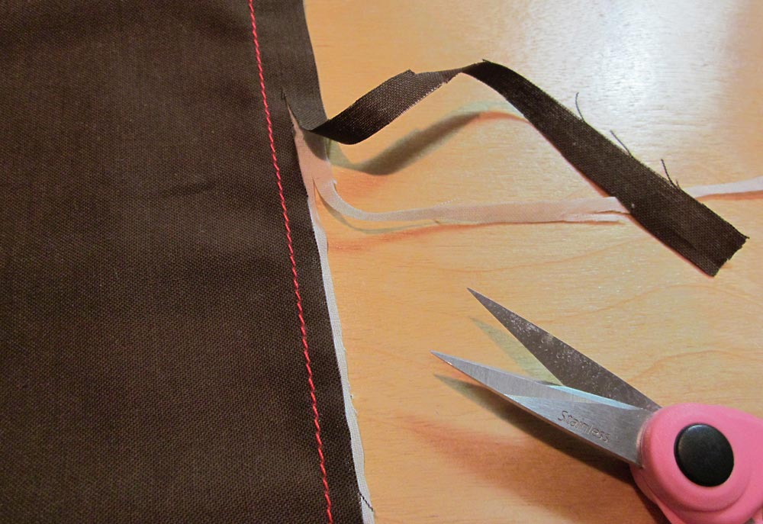
grading
the seam allowances are trimmed away at different widths. A person would do this when the seam is really thick with different layers.

Slide 13
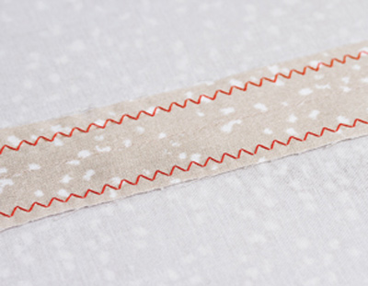
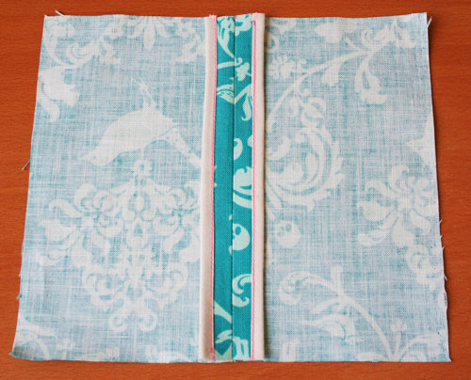
Seam finish
A seam finish is applied to the seam's raw edges to keep the fabric from raveling and to make the seam look neat and clean.
Zig zag, serged, hong kong finish, french seam

Slide 14
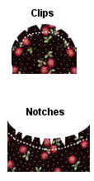
Clipping and Notching
Clipping and notching seam allowances allows the fabric to mold into a curve, without the seam allowance layers bunching up.

Slide 15
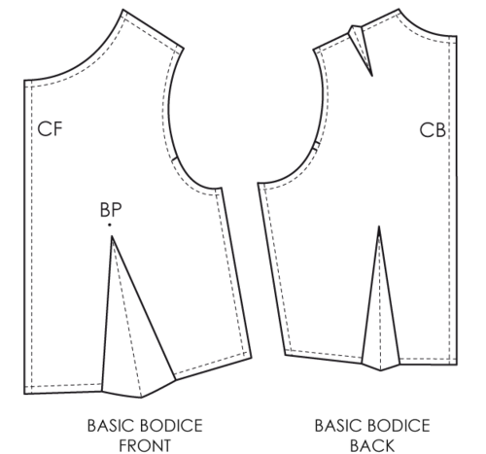
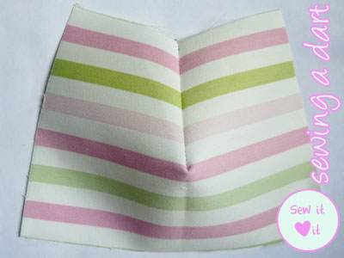
darts
are folds (tucks coming to a point) and sewn into fabric to take in ease and provide shape to a garment.

Slide 16
Wearing ease
The minimum amount of extra room added to a pattern to allow for comfortable, non-restricted movement.

Slide 17
Design ease
Added fullness beyond wearing ease incorporated into a pattern to create a specific silhouette.
Fitted , Semi fitted, Slightly fitted, Loosely fitted

Slide 18
Negative ease
Used for stretch fabrics that have more give and can stretch around your body comfortably by themselves. A negative ease garment will measure smaller than your actual body measurements, but will still stretch enough to fit you comfortably. Bathing suits and active wear, like yoga pants, will have negative ease.

Slide 19
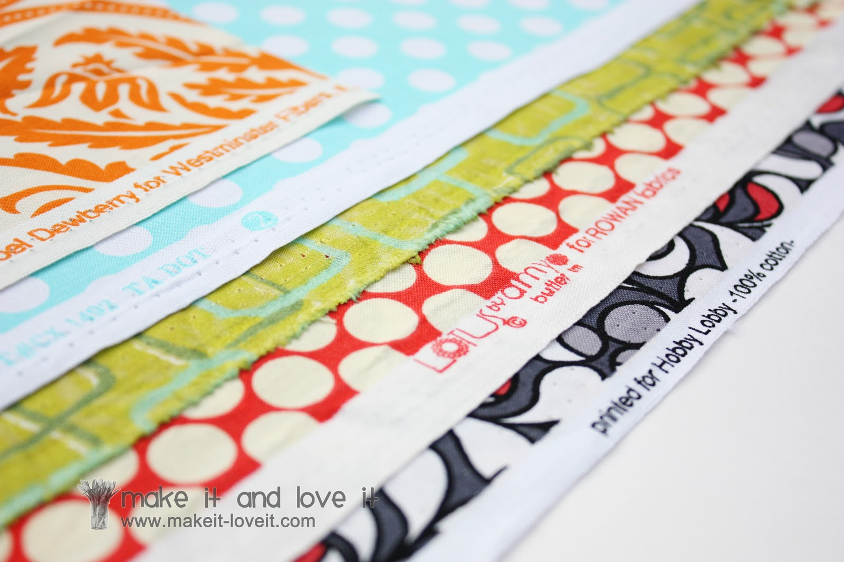
selvage
is a self-finished edge of fabric. The selvages keep the fabric from unraveling or fraying.

Slide 20
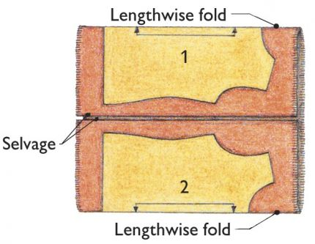
Lengthwise fold
fabric folded in half lengthwise so that selvages match. However, lengthwise folds can also be partial folds leaving some of the fabric extended as a single layer.
Double Lengthwise Fold
Fold like a Hotdog bun

Slide 21
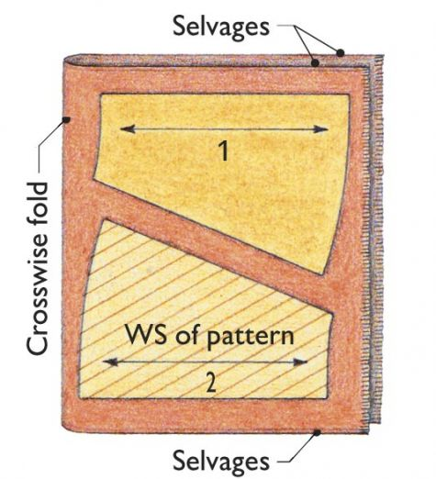
Cross wise fold
Folded so the cut or raw-edges match.
A crosswise fold is often used when pattern pieces are too wide to fit on fabric folded lengthwise.
You can also have a partial and double crosswise fold
Fold like a hamburger bun

Slide 22
Double fold
Folding the material so the selvage or raw/cut edges meet in the middle
be sure the full length of each folded side is the same width

Slide 23
Partial fold
Only fold part of the material so it is doubled and leave another piece single layered.
Leaving some of the fabric extended as a single layer.

Slide 24
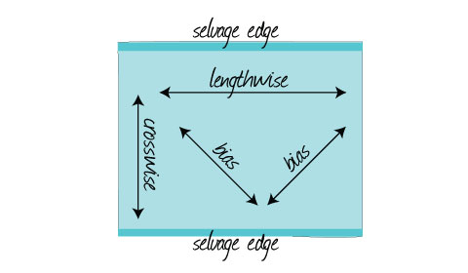
bias
45 degree angle from the crosswise or lengthwise grain of the fabric

Slide 25
pressing
To use the iron in an up and down motion applying downward pressure to the item

Slide 26
ironing
To use a back and forth motion on fabric to smooth out the wrinkles

